Slide 1

MWSUG BL-104 EXPLORE YOUR DATA BEFORE YOU RUSH TO ANALYSIS, YOU WILL THANK ME LATER: EXPLORATIONS IN CROSS SECTION DATA
Dr. Steven C. Myers
Department of Economics, College of Business Administration
The University of Akron
Myers@uakron.edu
econdatascience.com
LinkedIn.com/in/stevencmyers
https://github.com/campnmug/rent
Paper, slide deck, code and data →

Slide 2
DATA TAKES TIME!
Hasty data work is
ill-considered problem articulation,
insufficient data cleaning and proper data transformations
poorly developed and naive modeling
insufficient groundwork for statistical inference leading to unreliable conclusions
tempting because of pressure of getting to an answer quickly
And hasty is costly!
But DATA TAKES TIME!

Slide 3
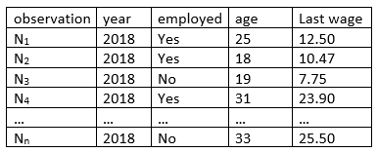
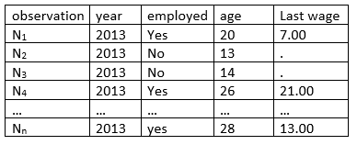
Structured Data Examples
Time Series data
Many observations on single variable measured at different points in time, ordered
Cross Sectional data
Many observations interviewed during
one time period, not-ordered
Special cases
Panel data
Different observations interviewed
each year
Longitudinal Data
Same observations re-interviewed
each year

Slide 4
Applied metrics Applying both theory and statistics to data analysis.
Problem Articulation
Formulate the question(s)
Solve the question(s) or at least
Formulate the way to answer
Acquire data
Data cleaning and preparation
Model specification

Slide 5
Problem Articulation versus the role of data
DATA
QUESTIONS¹
ANSWERS
“I have data let’s take a look!”
If you torture the data long enough, it will confess.
– Ronald Coase
¹Optional
DATA
QUESTIONS
ANSWERS
Data will lie to you!
- me
DATA
QUESTIONS
ANSWERS
Data Isn’t “Truth,” Kalev Leetaru, Forbes, May 7, 2019 accessed at https://www.forbes.com/sites/kalevleetaru/2019/05/07/data-isnt-truth on July 15, 2019.

Slide 6
Problem Articulation Are female students paying higher rents than male students and why? Questions and Answers before analysis
Rents should be higher as
The quantity of size of the apartment increases
The location is more preferred
The safety of ones person and property is higher
The quality of the apartment is higher
The price of substitute housing (dorm, homes) is higher.
Therefore:
Females will pay more if they prefer (1) to (5) more than males (explained difference)
Or
Females may pay more even if (1) to (5) are held constant (unexplained difference)
DATA I want DATA I have
RMPP
DIST
nothing
nothing
nothing

Slide 7
Are female students paying higher rents and Why?
Rental data on the campus of Ann Arbor involving gender, rooms, number of persons and distance from campus. N=32.
Variable Explanation
RENT Monthly apartment rent (dollars) on the apartment
NO Number of persons living in the apartment sharing of expense
RPP Rent/No is monthly rent charged per person
RM Number of rooms in the apartment quantity
DIST Distance in blocks from campus location
SEX Sex (0=male, 1=female)
No controls for safety, quality, or other housing prices.
Source: Pindyck and Rubinfeld, Econometric Models and Economic Forecasts, 4th edition, McGraw-Hill. (https://amzn.to/2q49OwA)

Slide 8
Are female students paying higher rents and why?
Rents should be higher as
The quantity of size of the apartment increases
(possible variables: No. rooms per person (RMPP), square-footage, sqft/room, private bedroom or shared)
The location is more preferred
(possible variables: Distance from campus (DIST), on bus line, bike path, commute time)
The safety of ones person and property is higher
(possible variables: Crime rate on block, crime rate along walking path, street lighting)
The quality of the apartment is higher
(Census block quality designation)
The price of substitute housing is higher.
(possible variables: Dorm costs, home cost)
Empirical Problem (PROC REG) Female [β, SE(β), α] Model summary .
RPP = f(RMPP,DIST,FEM,error) β = $20.02 ($16.59) α=.23 RMSE=$40 F= 5.24**

Slide 9
Four ways to treat sex (the variable ‘sex’ that is.)
RENAME Sex=Female; (and the lazy version is Sex=Female)
If SEX=1 then Female=1; Else Female=0;
LABEL SEX=’Female (1=female, 0=male)’;
proc format;
value gender 1 ='Female'
0 ='Male';
run;

Slide 10
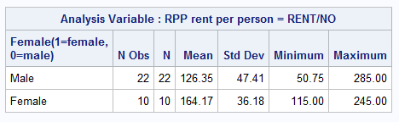
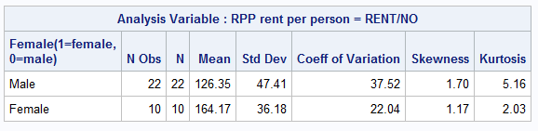
Are female students paying higher rents?
PROC FORMAT;
value gender 1 ='Female'
0 ='Male';
run;
PROC MEANS data=rents maxdec=2;
/* default stats */
class sex;
var rpp ;
format sex gender.;
run;
PROC MEANS data=rents maxdec=2
n mean std cv skew kurtosis;
class sex;
var rpp ;
format sex gender.;
run;

Slide 11
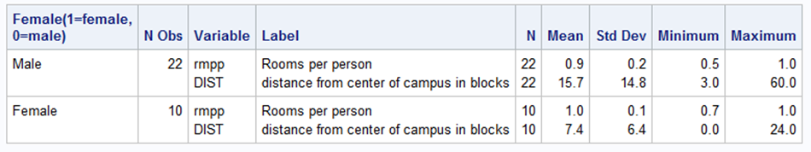
A funny thing happened on my way to RPP/SEX correlation – I met some confounding variables.
Title1 'Measures of confounding variables';
PROC MEANS data=rents maxdec=1 ;
class sex;
var rmpp dist;
format sex gender.;
run;
RMPP appears to be
approximately the same
Females seem to prefer living closer to campus
With a lower variation too.

Slide 12
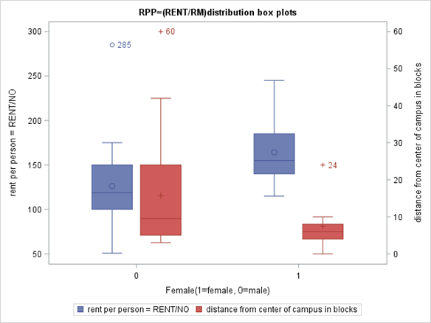
Illustrate with PROC SGPLOT, box plots
Title2 'RPP=(RENT/RM)distribution box plots';
PROC SGPLOT data=rents;
vbox rpp /category=sex
boxwidth=0.25
discreteoffset=-0.15
datalabel;
vbox dist/category=sex
boxwidth=0.25
discreteoffset=+0.15
datalabel
y2axis;
run;

Slide 13
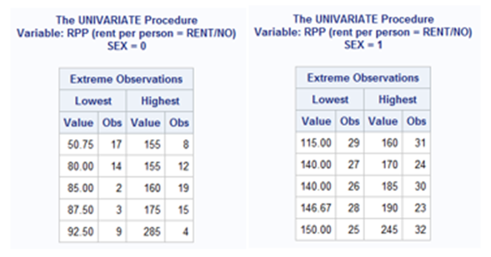
PROC UNIVARIATE – EXTREME VALUES
ods select extremeobs ;
PROC UNIVARIATE data=rents;
var rpp dist;
class sex;
run;
?
From Box Plot

Slide 14
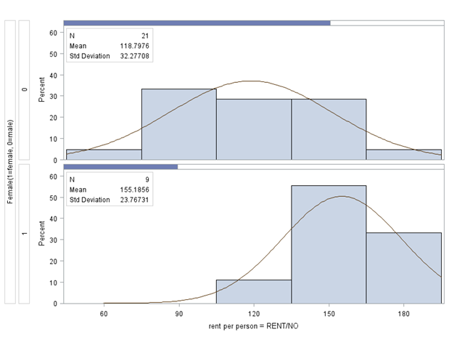
PROC UNIVARIATE HISTOGRAM OF RPP
PROC UNIVARIATE data=rents noprint;
class sex;
histogram RPP /
midpercents nrows=2
intertile=1
cprop normal(noprint);
inset n = "N" mean std
/pos = nw;
where RPP < 245;
run;

Slide 15
Alternative to deleting observations
Marking the three outliers identified clearly by the box plots.
Full Sample Size = 32
PROC REG;
Model RPP = SEX RMPP DIST M1 M2 M3 ;
DATA rent2;
set rents;
length clean $3;
if sex=0 and RPP=285 then M1=1; else M1=0;
if sex=0 and dist=60 then M2=1; else M2=0;
if sex=1 and dist=24 then M3=1; else M3=0;
if sum(of M1, M2, M3) = 0 then clean='yes'; else clean='no';
run;
identical
parameters estimates
and standard errors and
root MSE, but the marked
missing values preserve the full sample.
Restricted Sample size = 29
PROC REG;
Model RPP = SEX RMPP DIST;
Where clean = ‘yes’;

Slide 16
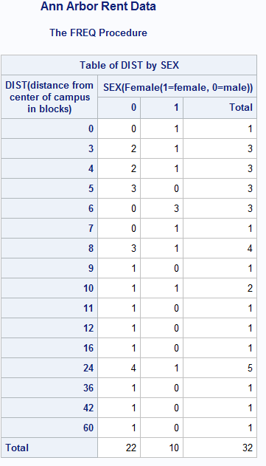
PROC FREQ as a EDA Tool: Does distance matter?
PROC FREQ data=rentdata.rent2;
tables dist*sex /norow nocol nocum noprecent;
run;
Hard to read and doesn’t deal with RENT
PROC MEANS data=rentdata.rent2 maxdec=2;
class sex dist;
var rent rpp no rm ;
run;
NO!
Too much output.
Not easy to read or use.

Slide 17
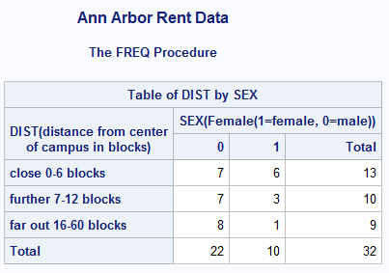
Formatting for easier analysis / easier reading
PROC FORMAT ;
value distance 0-6 ='close 0-6 blocks'
7-12 ='further 7-12 blocks'
13-60 ='far out 16-60 blocks' ;
value gender 1 ='Female'
0 ='Male';
run;
PROC FREQ data=rentdata.rent2;
tables dist*sex /norow nocol nocum noprecent;
format dist distance. sex gender.;
run;
Easier to read.
Still doesn’t deal with RENT

Slide 18
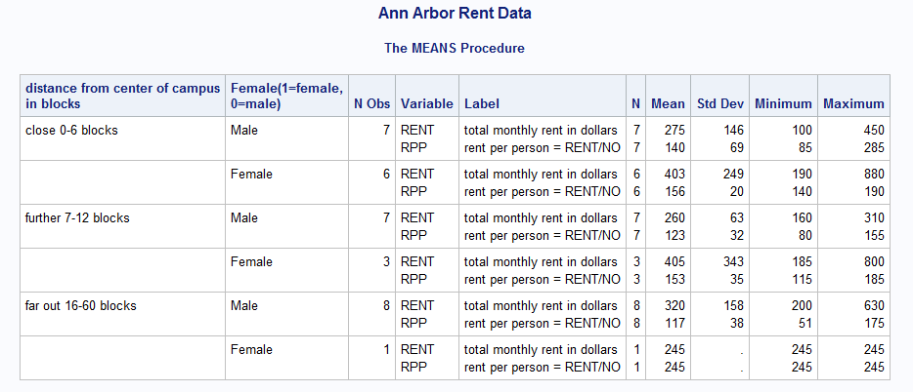
PROC MEANS using your defined FORMAT statements
PROC MEANS data=rentdata.rent2 maxdec=2;
class dist sex;
var rent rpp;
format dist distance. sex gender.;
run;
Now it is easier to understand.

Slide 19
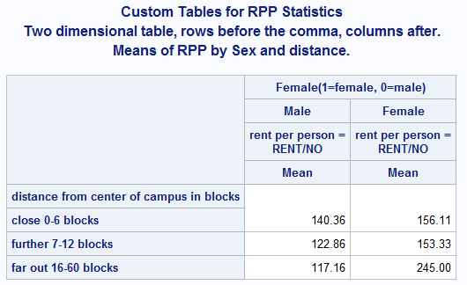
PROC TABULATE for more information in one place
Title1 'Custom Tables for RPP Statistics';
Title2 'Two dimensional table,
rows before the comma, columns after.';
Title3 'Means of RPP by Sex and distance.';
PROC TABULATE data=rent2;
class dist no rm sex ;
var rent rpp ;
Table dist , sex*rpp*mean;
format dist distance. sex gender.;
run;

Slide 20
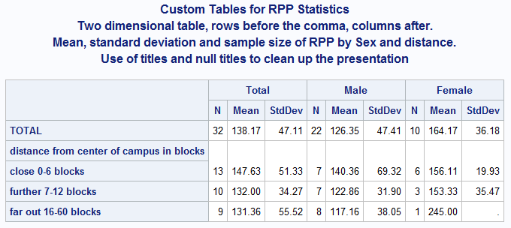
Now mean and std of RPP by distance and sex
PROC TABULATE data=rent2;
class dist no rm sex ;
var rent rpp ;
Table
(all=Total dist) ,
(all='Total' sex='')*rpp=''*(n mean stddev);
format dist distance. sex gender.;
run;

Slide 21
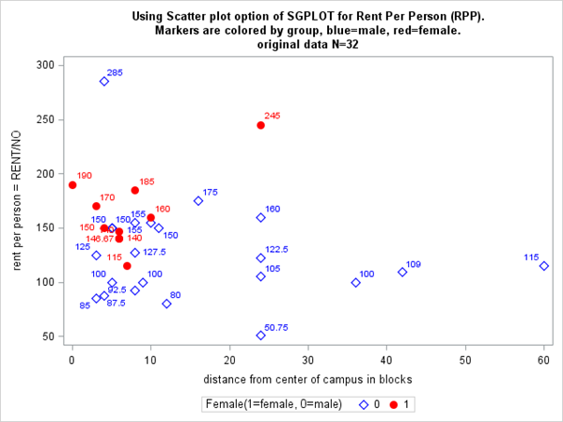
Scatterplots bring more clarity
ODS GRAPHICS /
ATTRPRIORITY=NONE;
PROC SGPLOT data=rent2;
styleattrs
datasymbols=(diamond circleFilled )
datacontrastcolors=(blue red);
scatter y=RPP x=dist /
group=sex
Markerattrs=(size=10px) datalabel ;
run;

Slide 22
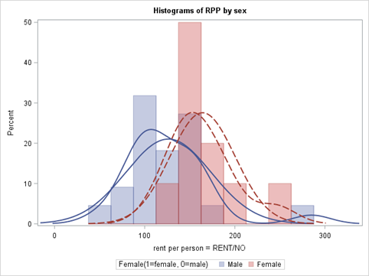
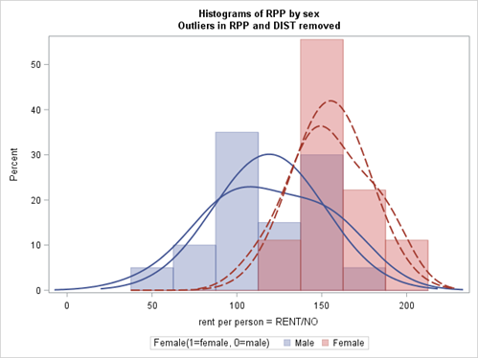
More detailed histograms from PROC SGPLOT
Full dataset, N=32
Cleaned dataset, N=29
0 100 200 300
0 100 200
PROC SGPLOT data=rent2;
histogram RPP / Group=sex transparency=.6 binwidth=25;
density RPP / group=sex type=kernel;
density RPP / group=sex type=normal;
where clean='yes';
format dist distance. sex gender.;
run;

Slide 23
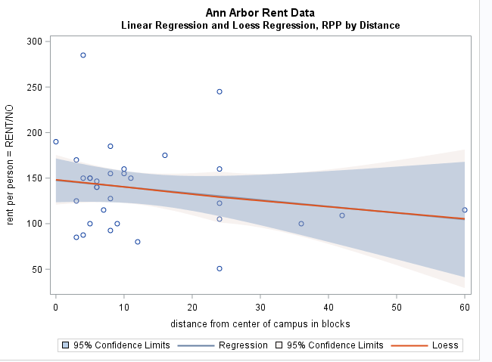
Linear versus nonparametric regression of RPP=f(DIST)
PROC SGPLOT data=rentdata.rent2;
reg x=dist y=rpp /
clm clmtransparency=0 ;
loess x=dist y=rpp /
clm clmtransparency=.7 nomarkers ;
run;
Linear regression line
= Loess line.

Slide 24
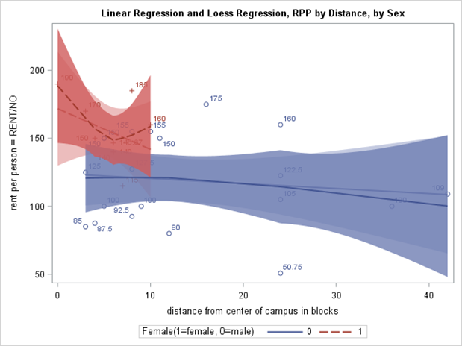
Linear versus nonparametric regression of RPP=f(DIST, SEX)
PROC SGPLOT data=rent2;
reg x=dist y=rpp / group=sex clm clmtransparency=.6 datalabel;
loess x=dist y=rpp / group=sex clm clmtransparency=.2 nomarkers ;
where clean='yes';
run;
Word of the day:
Heterogeneity
Females pay higher rents
on-campus or farther away
from campus. They apparently
pay premiums that their male
counterparts do not.

Slide 25
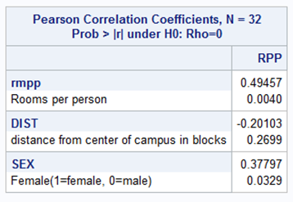
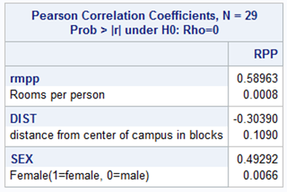
PROC CORR to show pairwise relationships
Title2 'PROC CORRELATION';
PROC CORR data=rent2;
var rpp;
with rmpp dist sex;
run;
Title2 'PROC CORRELATION on clean dataset';
PROC CORR data=rent2;
var rpp; with rmpp dist sex;
where clean='yes';
run;
All correlations with RPP are
stronger on the clean data.

Slide 26
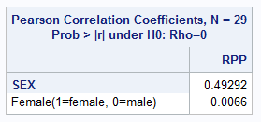
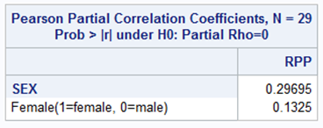
Partial Correlations of RPP and SEX holding constant RMPP and DIST
title2 'Partial correlation of
RPP and SEX, holding constant
DIST and RMPP, on cleaned dataset';
PROC CORR data=rent2;
var rpp; with sex;
partial RMPP DIST;
where clean='yes';
run;

Slide 27
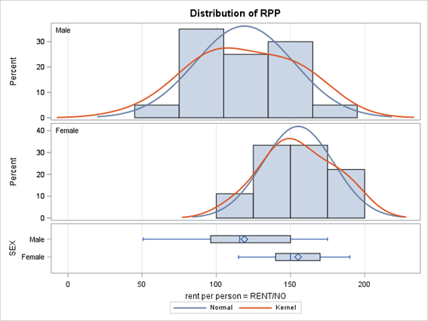
PROC TTEST A STATISTICAL TEST OF DIFFERENCE BETWEEN 2 MEANS
Title2 'Testing the average
Rent (or RPP) difference
between males and females.';
PROC TTEST data=rent2;
class sex;
var rpp;
where clean='yes';
format SEX gender.;
run;

Slide 28
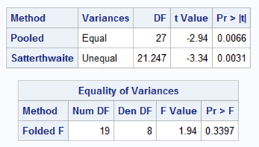
PROC TTEST A STATISTICAL TEST OF DIFFERENCE BETWEEN 2 MEANS
Title2 'Testing the average
Rent (or RPP) difference
between males and females.';
PROC TTEST data=rent2;
class sex;
var rpp;
where clean='yes';
format SEX gender.;
run;

Slide 29
Linear Regression
Title1 'Linear Regression and fully interactive model with and without outlier marks';
PROC REG data=rent2;
model_1: model rpp = rmpp dist sex;
model_2: model rpp = rmpp dist sex femrmpp femdist;
Test_2: test sex = femrmpp=femdist=0;
model_1b: model rpp = rmpp dist sex m1 m2 m3;
model_2b: model rpp = rmpp dist sex femrmpp femdist m1 m2 m3;
Test_2b: test sex = femrmpp=femdist=0;
run;
Title2 'Linear Regression fully interactive model after outliers removed from data';
PROC REG data=rent2;
model_1a: model rpp = rmpp dist sex;
model_2a: model rpp = rmpp dist sex femrmpp femdist;
Test_2a: test sex=femrmpp=femdist=0;
output out=rentr rstudent=rstudent;
where clean='yes';
run;

Slide 30
Fully interactive model
Let Y = RPP and F=female and b. Then the fully interactive model is written as
Y = b₁ + b₂*F + b₃*RMPP + b₅*RMPP*F + b₄*DIST + b₆*DIST*F + e
Male sample, where F=0 Y = b₁ + b₃*RMPP + b₄*DIST + e
(3) Female sample, where F=1 Y = (b₁+b₂) + (b₃+b₅)*RMPP + (b₄+b₆)*DIST + e

Slide 31
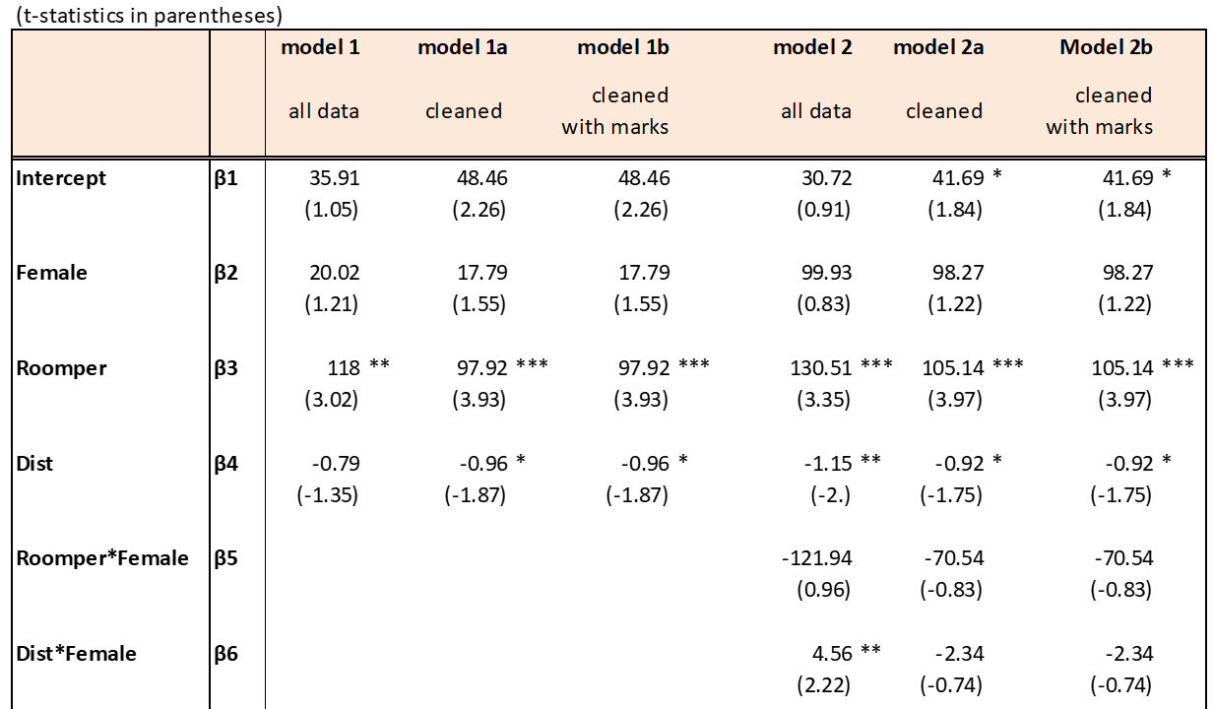
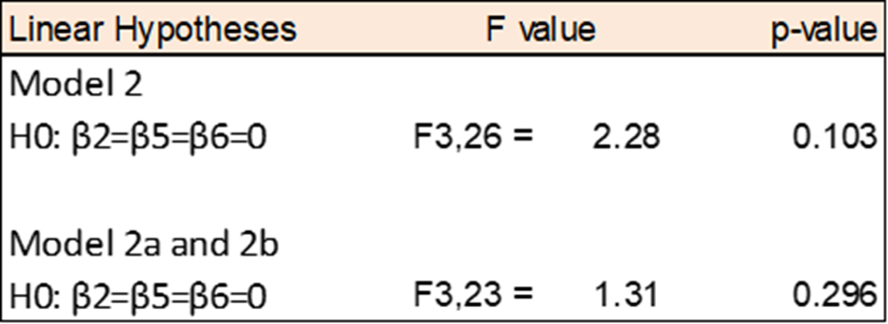
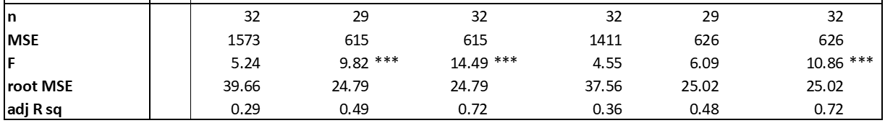
1
1
¹model 1b and 2b contain M1, M2 and M3

Slide 32
Conclusions
Problem solving and telling the story are essential
Data is hard
Data takes time
Data is costly
EDA to determine irregularities in the data is essential
It is essential to discover the DGP
Results are sensitive
Have to be humble in the face of data limitations

Slide 33
Dr. Steven C. Myers
Myers@uakron.edu
econdatascience.com
LinkedIn.com/in/stevencmyers
https://github.com/campnmug/rent

